Slide 1
Comparing model with simulation

Slide 2
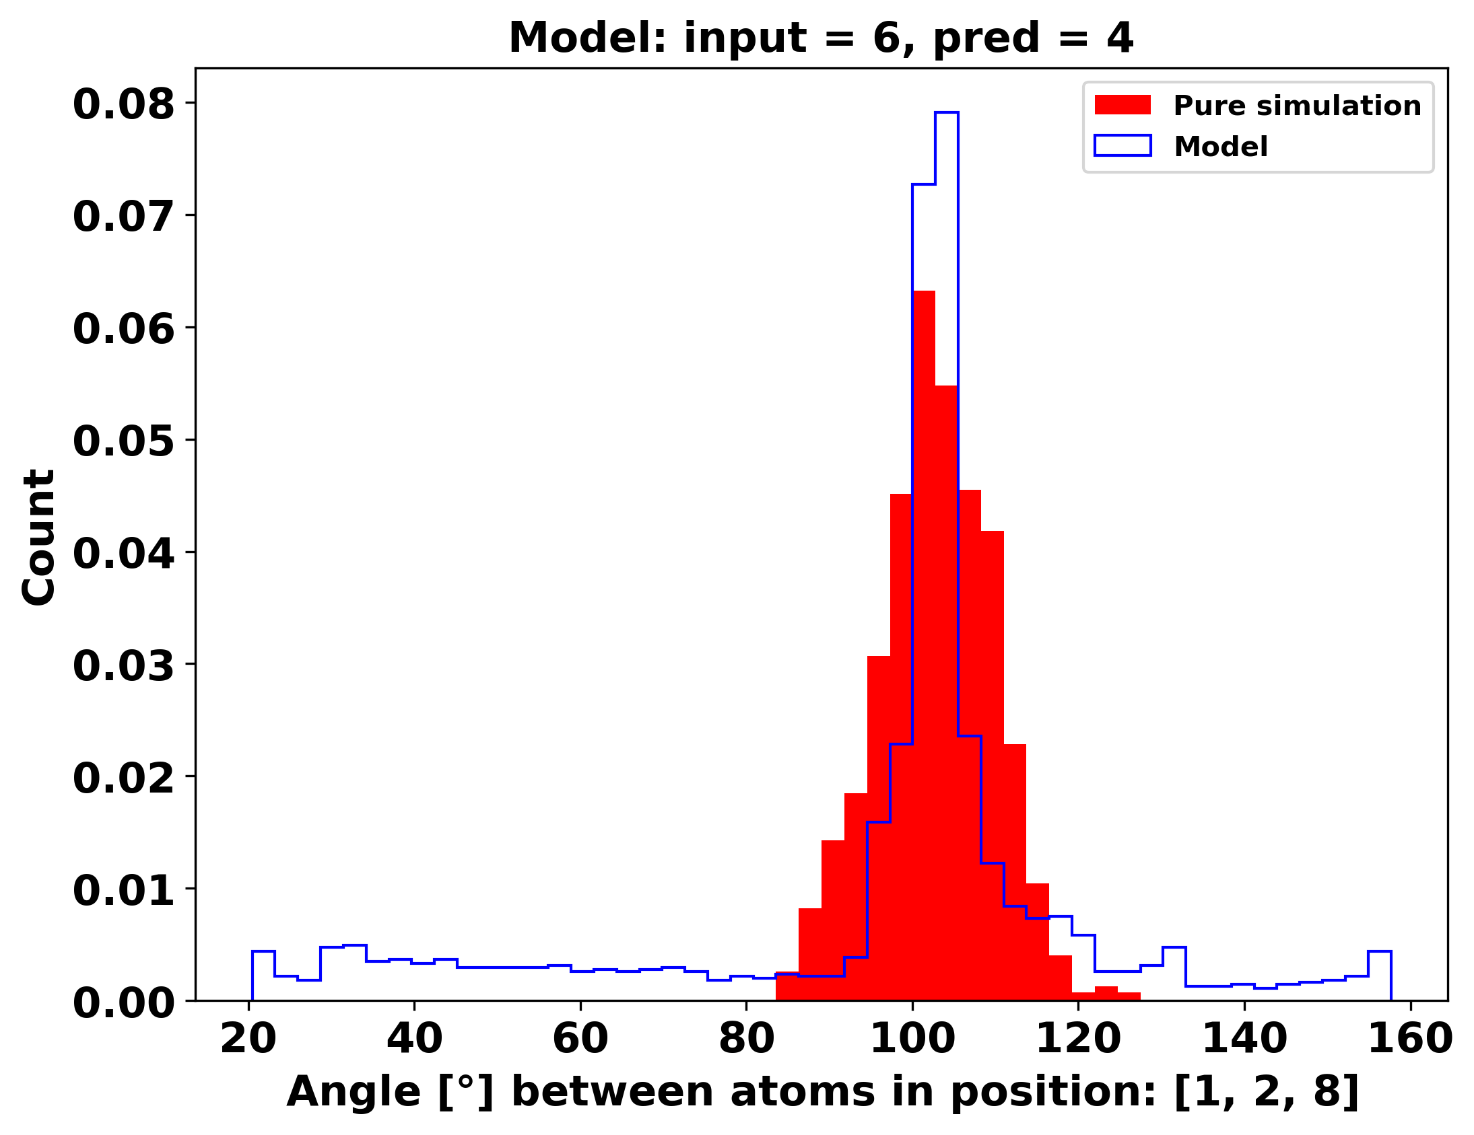
Comparing angle Model mae: 0.00131 Å mae at last pred: 0.0294 Å

Slide 3
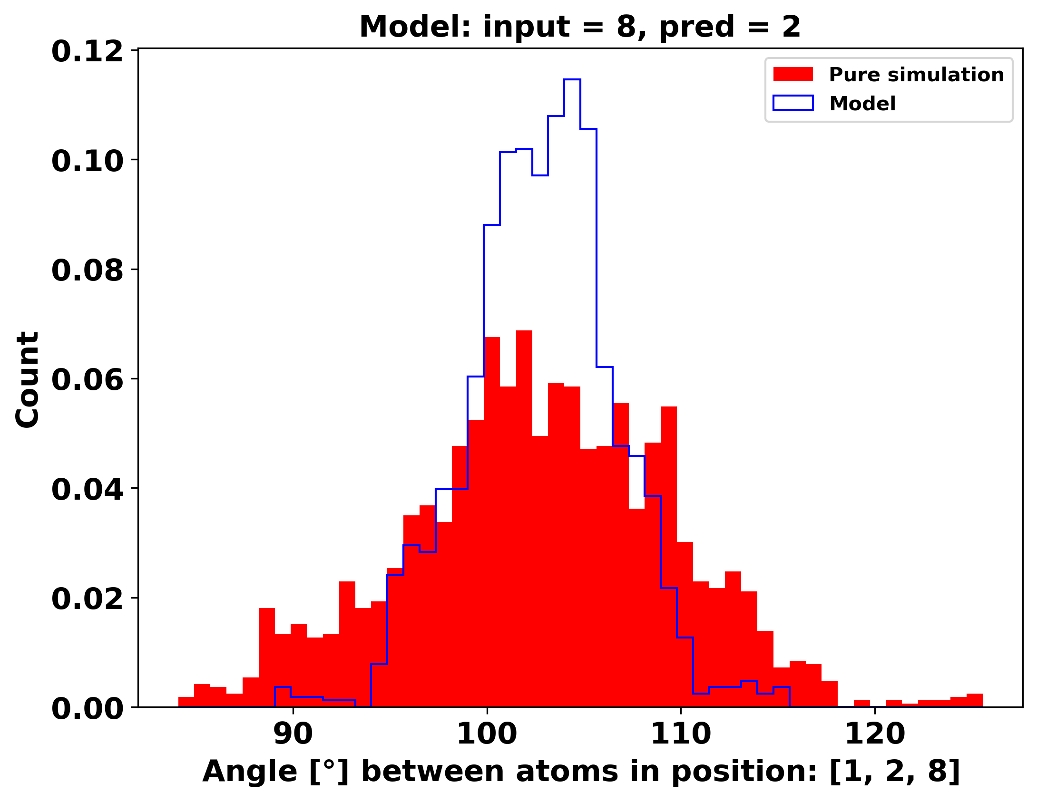
Comparing angle Model mae: 0.012 eV/Å

Slide 4
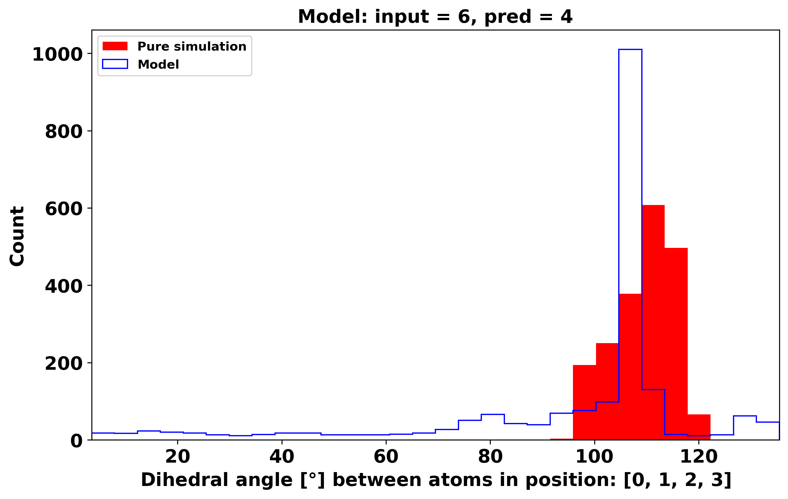
Comparing dihedral Model mae: 0.056 eV/Å

Slide 5
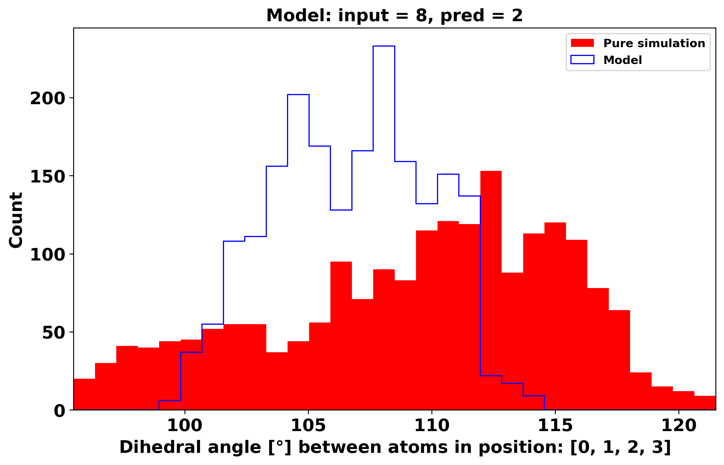
Comparing dihedral Model mae: 0.012 eV/Å

Slide 6
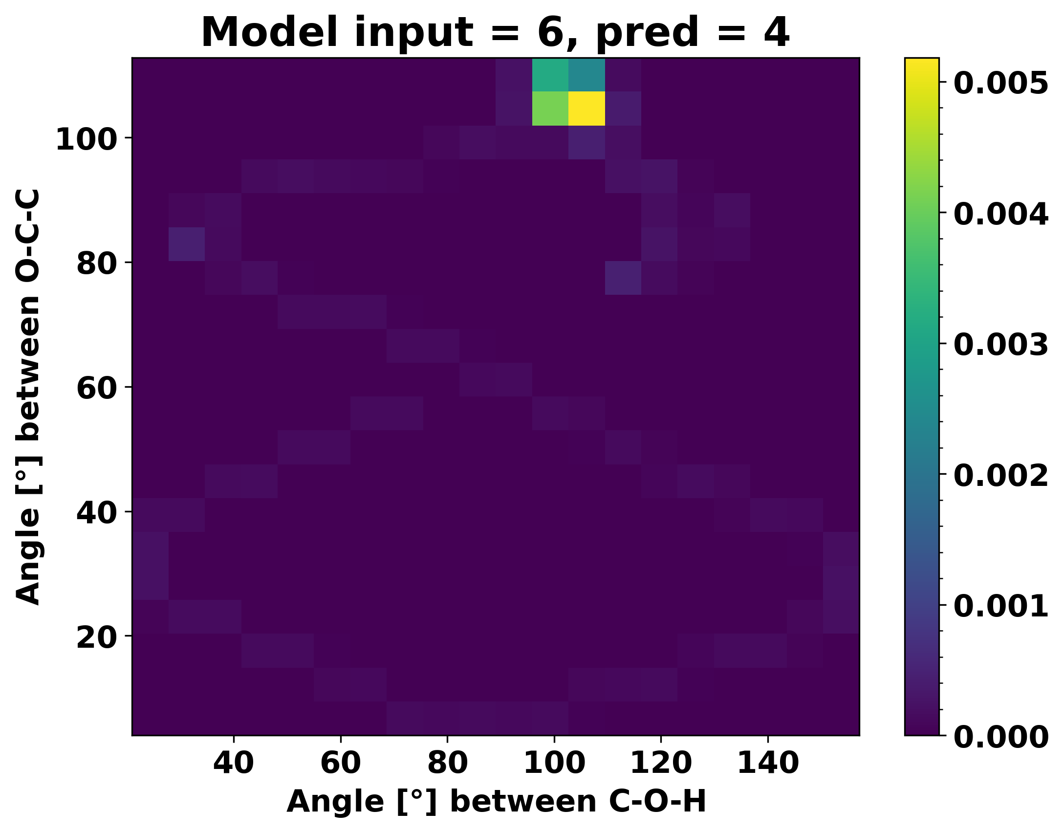
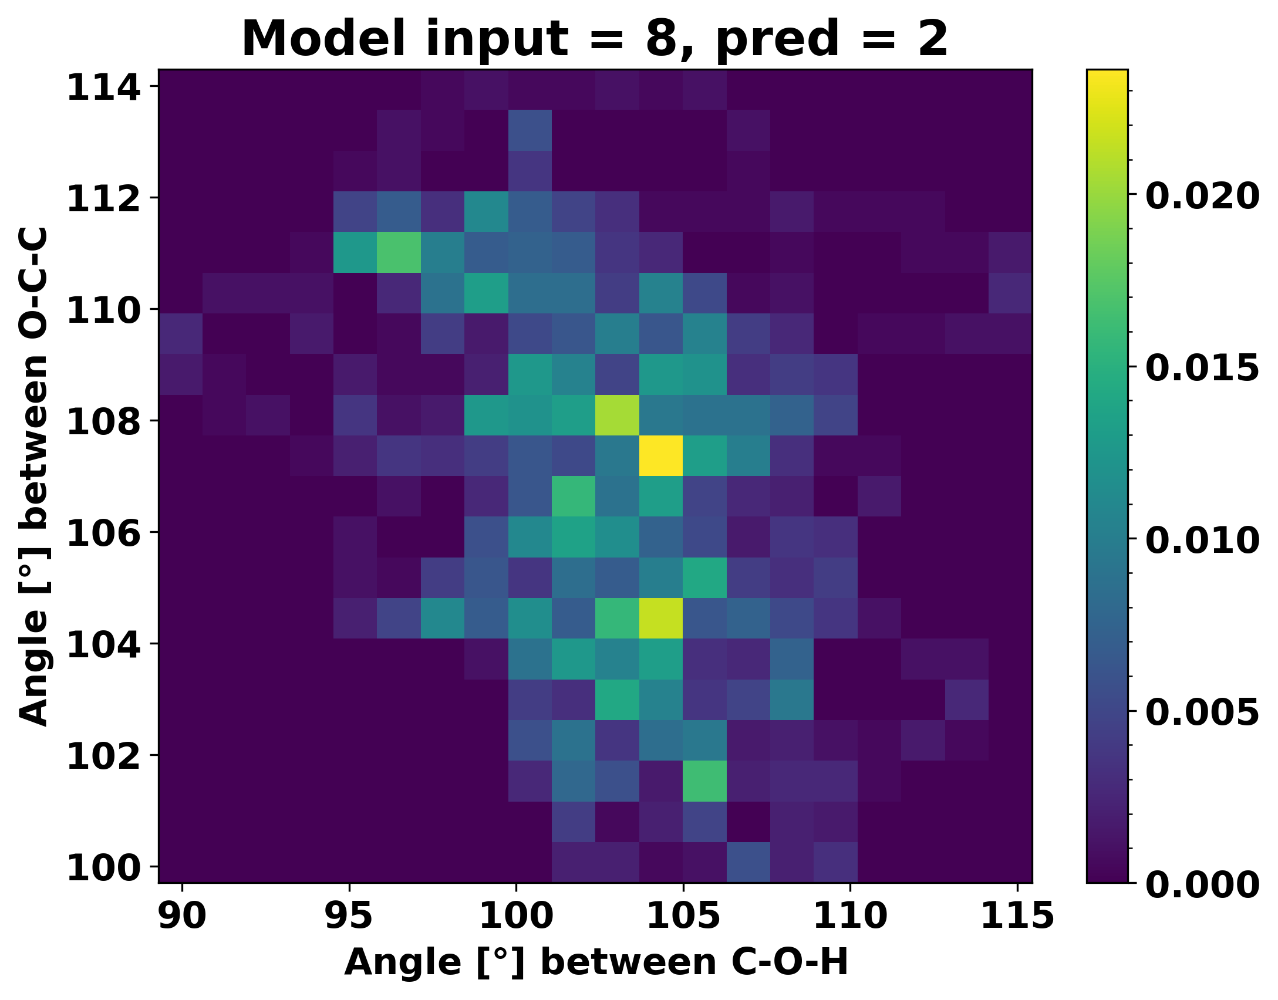
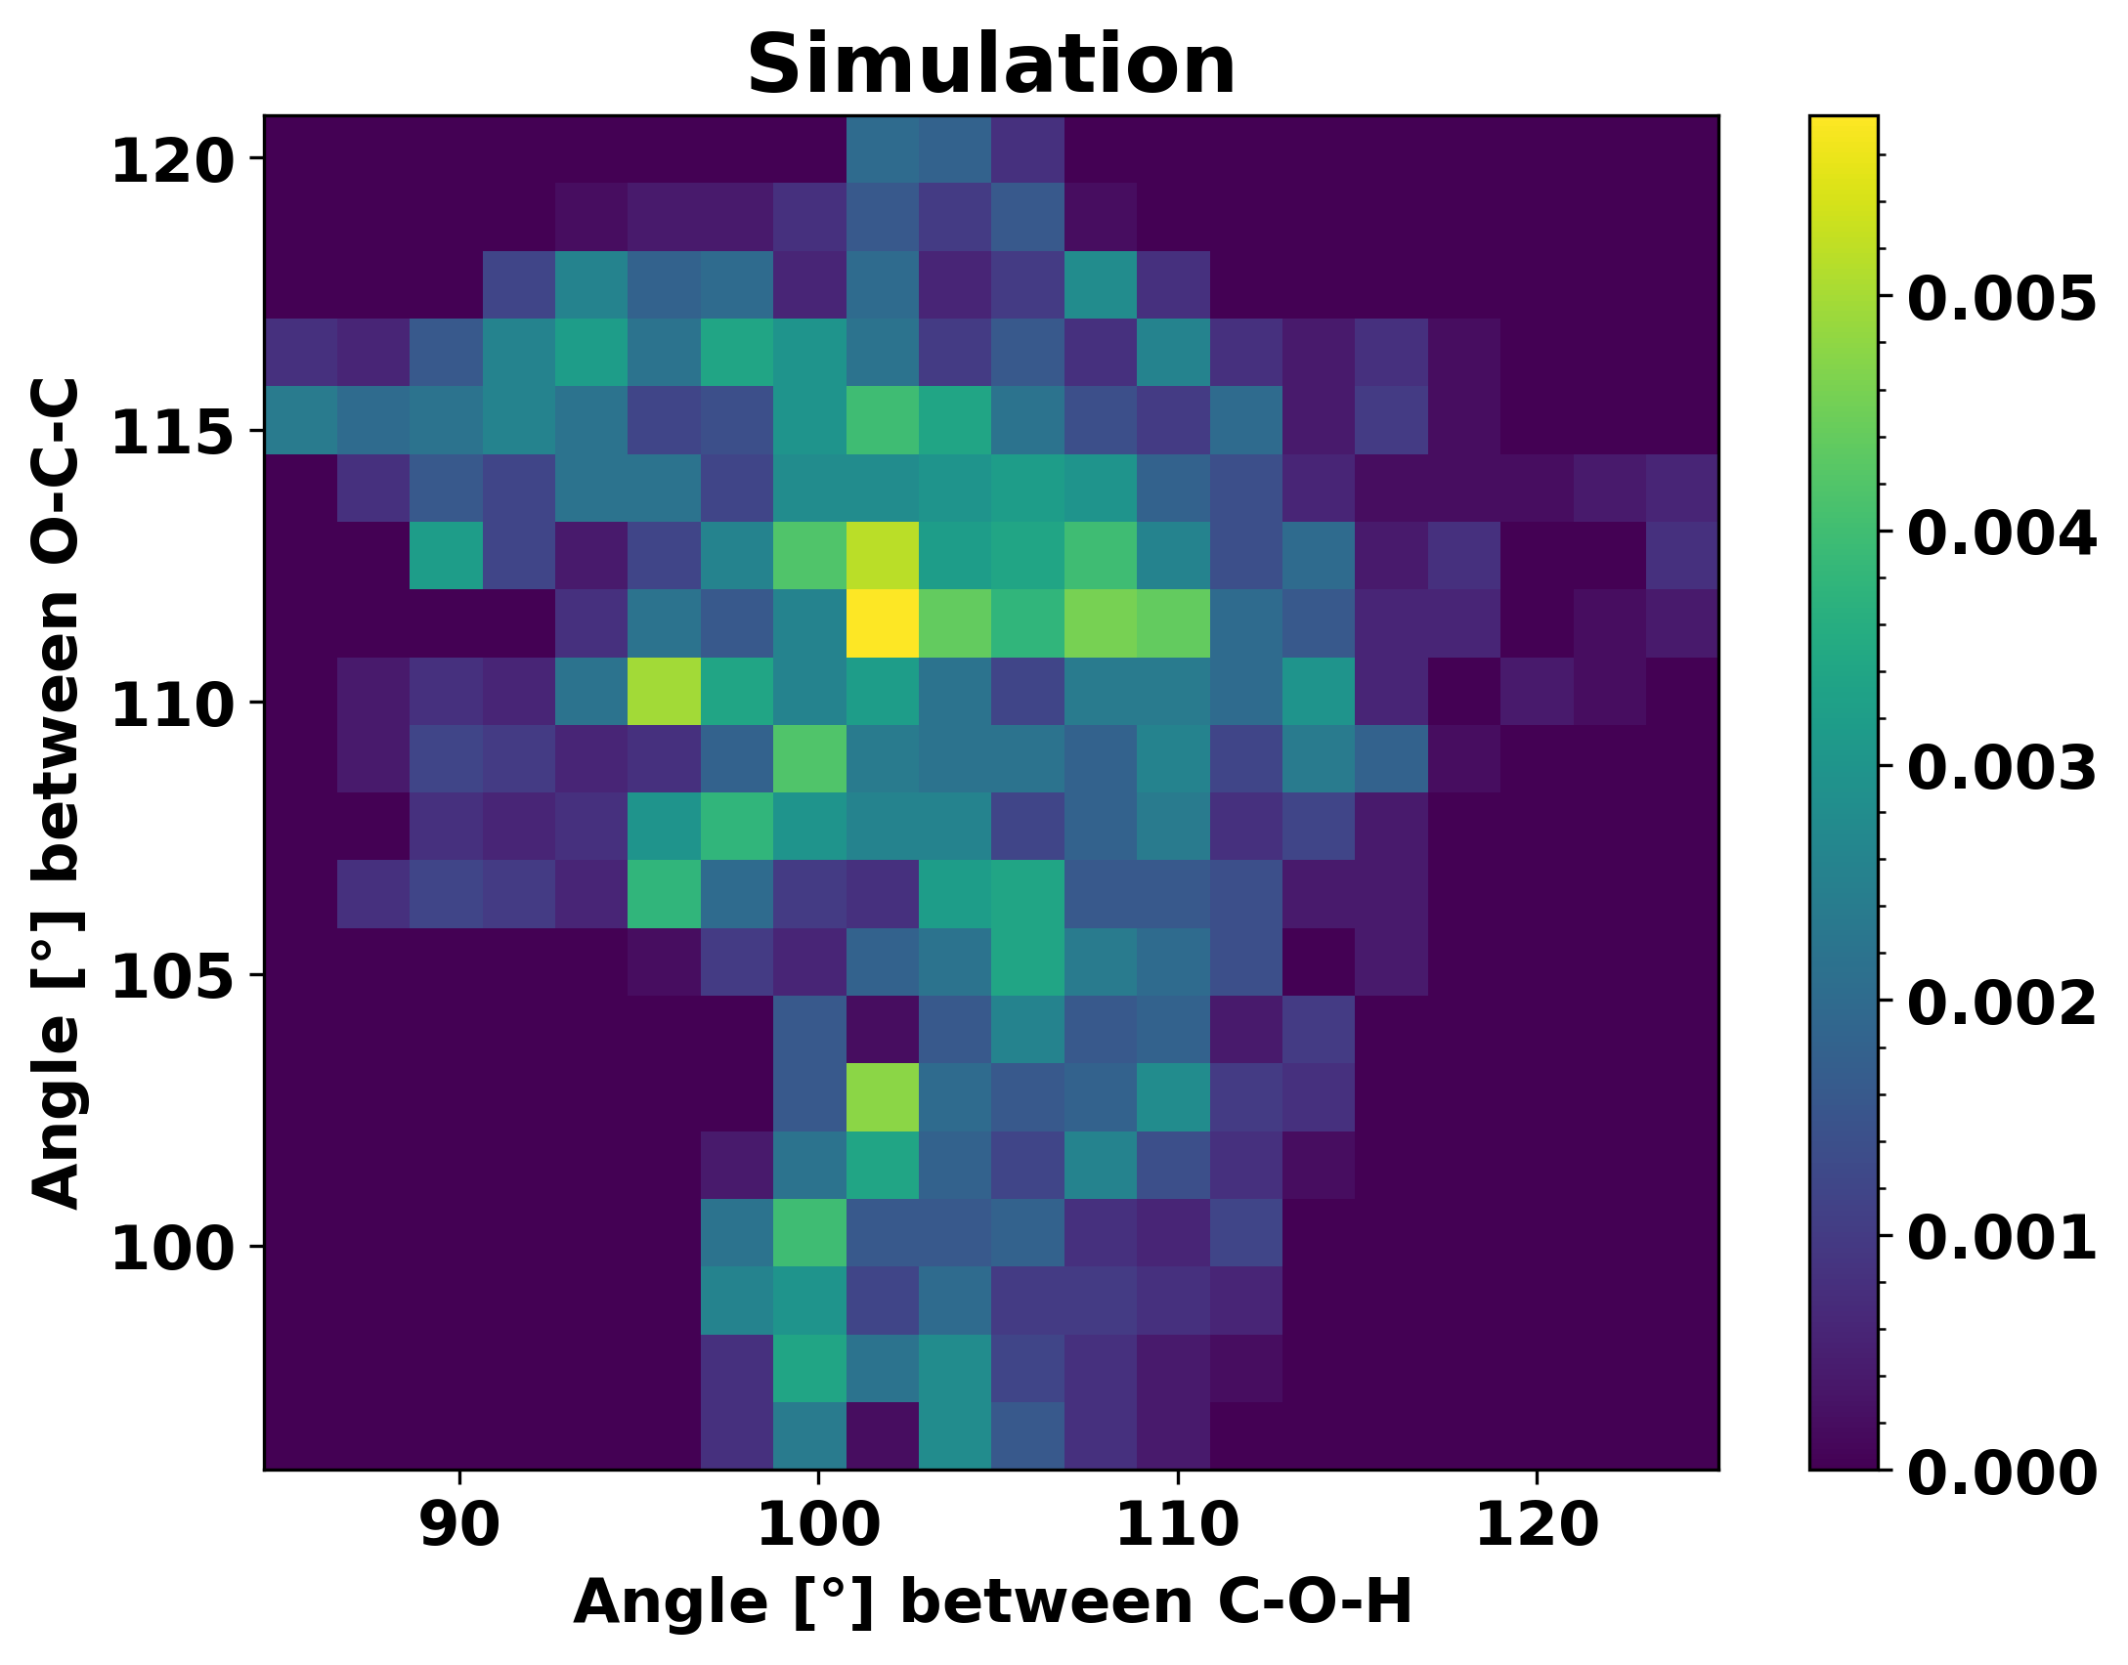
Dihedral

